Slide 1
Data Processing
Tomasz Krawczyk

Slide 2

?

Slide 3
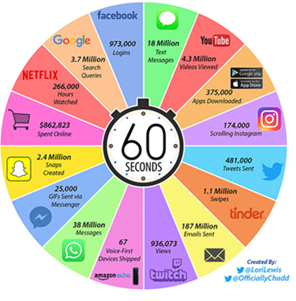
Internet Minute
Google - 3.7 Million Search Queries
Twitter – 481.000 Tweets Sent
18 Million Text Messages
187 Million Emails Sent
Source:https://www.visualcapitalist.com/internet-minute-2018/

Slide 4
40 Zetta bytes by 2020 163 Zetta bytes by 2025
Byte One grain of rice
Kilobyte Cup of rice
Megabyte 8 bags of rice
Gigabyte 3 semi trucks
Terabyte 2 container ships
Petabyte Blankets Manhattan
Exabyte Blankets west coast states
Zettabyte Fills the Pacific Ocean
Yottabyte As earth-sized rice ball

Slide 5
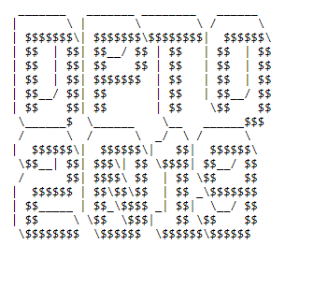
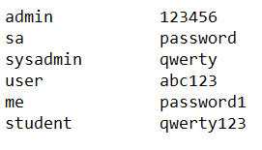
Value of Data
FILE 1
FILE 2

Slide 6
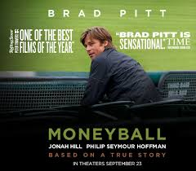
Do you know…
Moneyball is a 2011 American sports film directed by Bennett Miller and written by Steven Zaillian and Aaron Sorkin. The film is based on Michael Lewis's 2003 nonfiction book of the same name, an account of the Oakland Athletics baseball team's 2002 season and their general manager Billy Beane's attempts to assemble a competitive team.
In the film, Beane (Brad Pitt) and assistant GM Peter Brand (Jonah Hill), faced with the franchise's limited budget for players, build a team of undervalued talent by taking a sophisticated sabermetric approach to scouting and analyzing players.

Slide 7

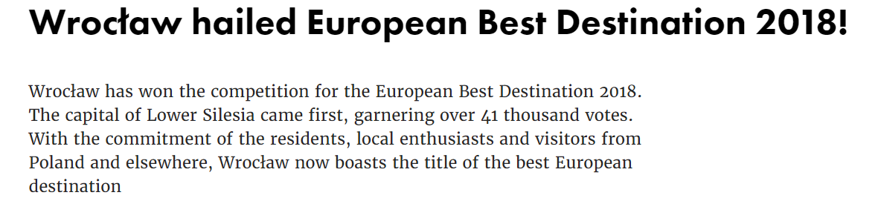


Do you know…

Slide 8
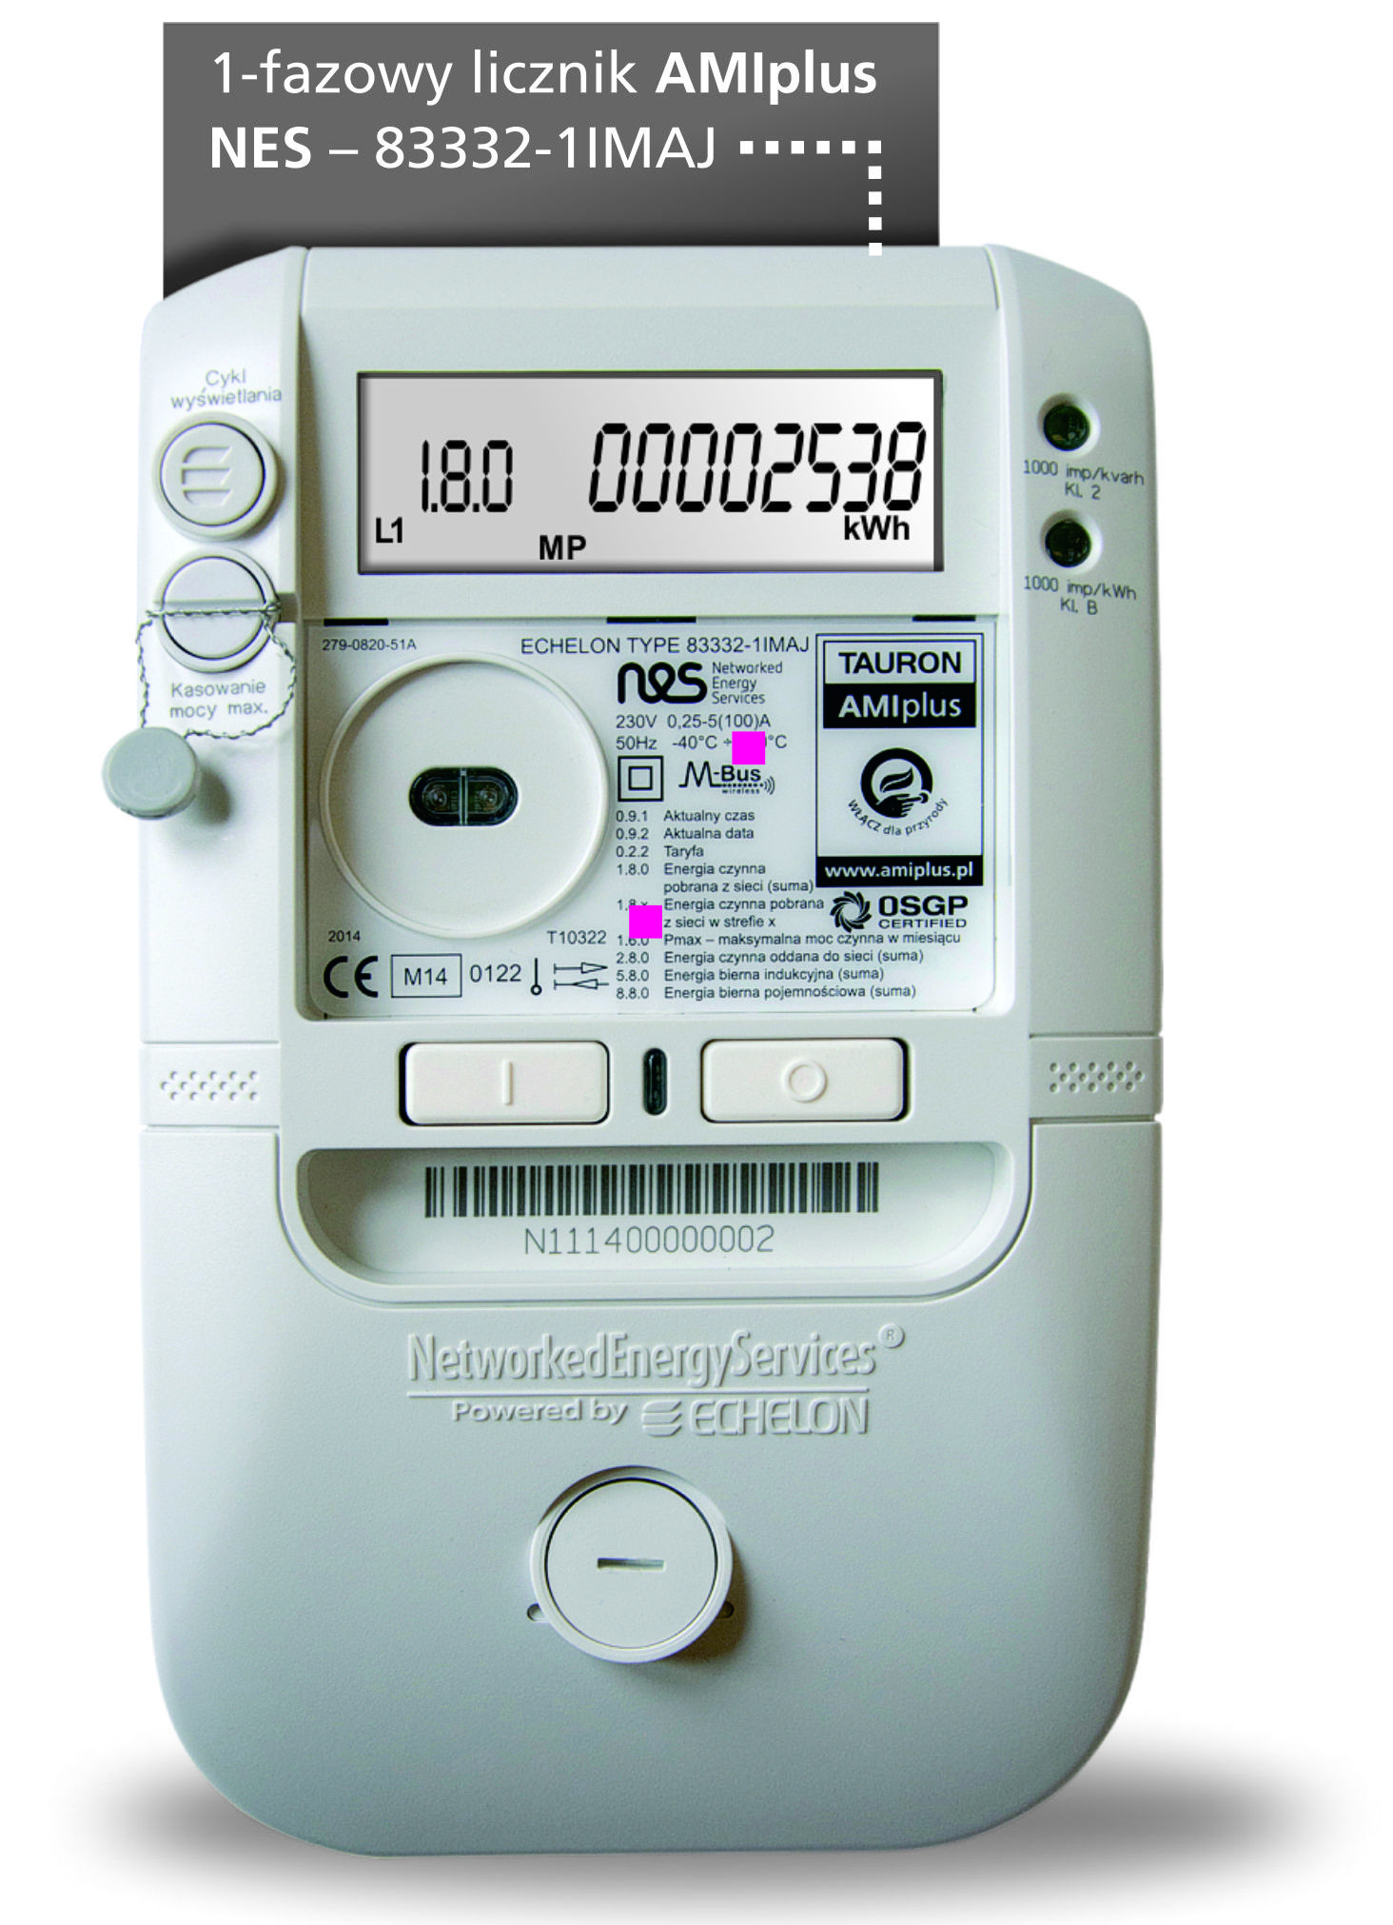
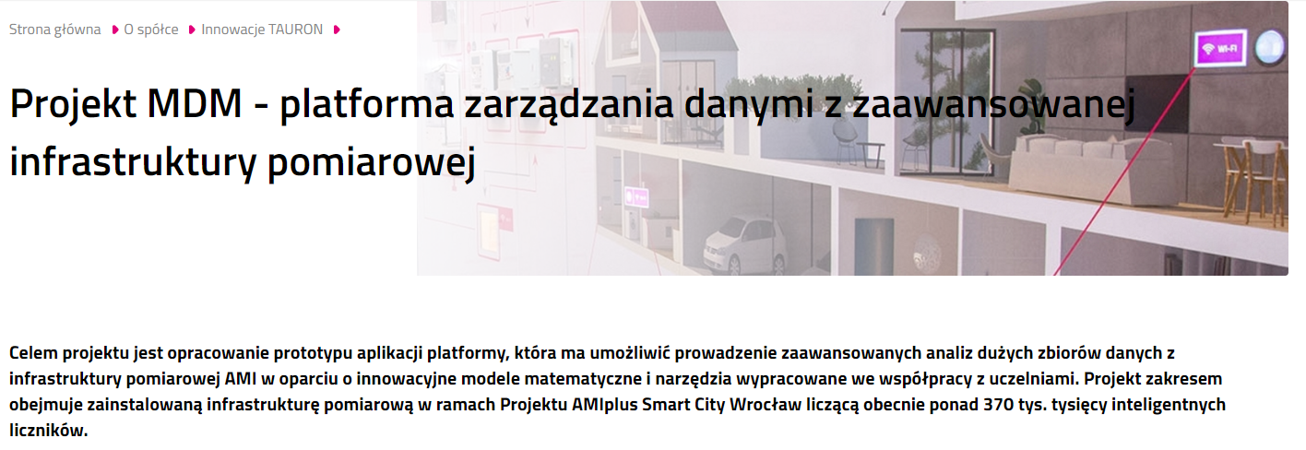
Do you know…
Notes:
Teraz powiem kilka słów o projekcie w którym aktualnie pracuje
Wrocław

Slide 9
History…

Slide 10
My First Application
Data
Application
(Pascal)

Slide 11
My First Application
Engine
Data
Application
SQL

Slide 12
Relation Model
Table Name
Books
Column Name
Id | Title
1 | Data Science in the Cloud
2 | Fast Data Processing with Spark, 2nd Edition
3 | Building Machine Learning Systems with Python
Tuple/Row
Row Id
Column

Slide 13
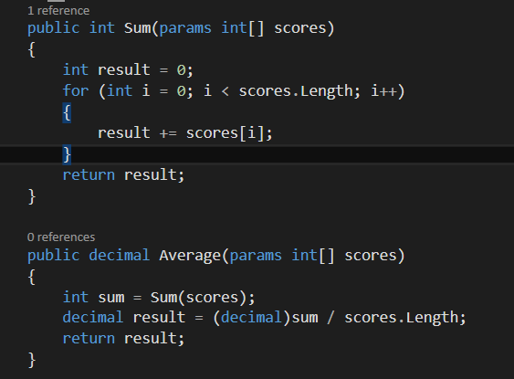
SQL
BookId | Score
1
2
1
2
SELECT AVG(Score) AS AvgScore FROM Scores WHERE BookId = 1

Slide 14
SQL
BookId | Score
1
2
1
2
SELECT BookId ,AVG(Score) AS AvgScore
FROM Scores GROUP BY BookId
ORDER BY AvgScore DESC

Slide 15
SQL
BookId | Score
1
2
1
2
Id | Title
1 | Data Science in the Cloud
2 | Fast Data Processing with Spark, 2nd Edition
3 | Building Machine Learning Systems with Python
SELECT b.Title FROM Books b WHERE b.Title LIKE '%Machine Learning%'
SELECT DISTINCT b.Title FROM Books b
JOIN Scores s ON s.BookId = b.Id
WHERE b.Title LIKE '%Machine Learning%'
AND s.Score>3

Slide 16
Relational Model -Challenges
Books
Id | Title
1 | Data Science in the Cloud
2 | Fast Data Processing with Spark, 2nd Edition
3 | Building Machine Learning Systems with Python
Release date
2017-04
BookId | Author
1 | Stephen F. Elston
2 | Krishna Santar
3 | Willi Richert
3 | Luis Coelho Pedro
BookId | Comment
1
1 | Ok
3 | Super

Slide 17
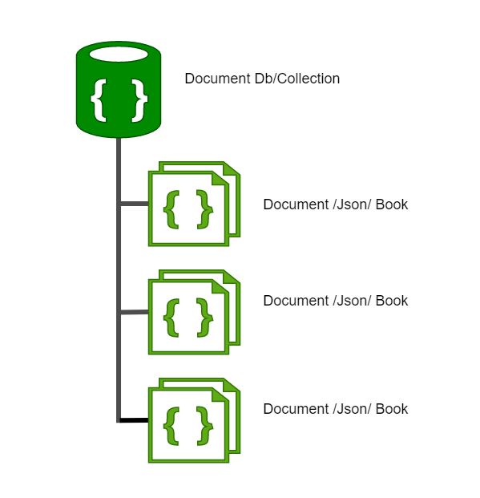
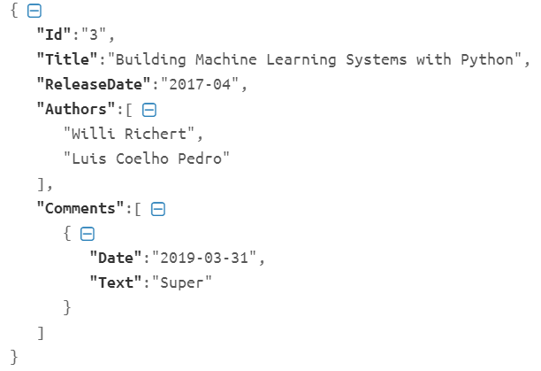
Document Db

Slide 18
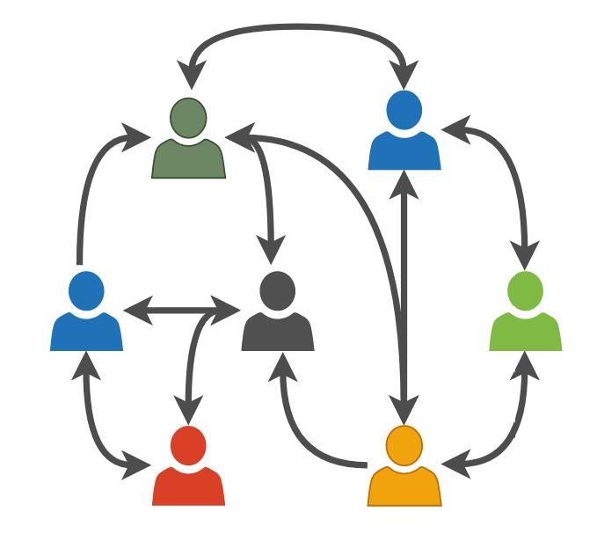
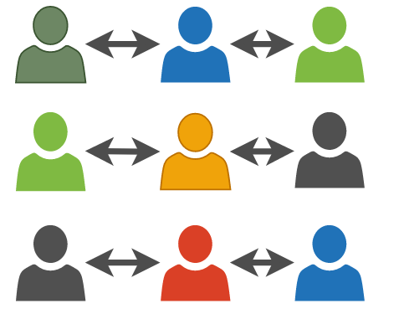
New Challenges

Slide 19
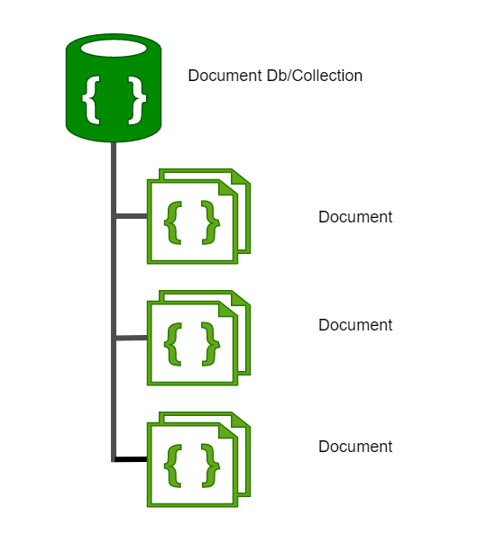
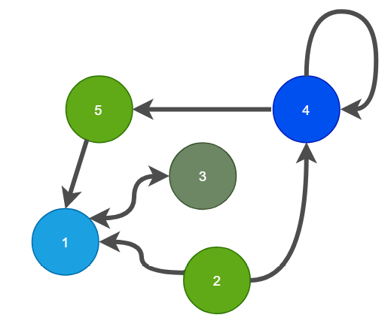
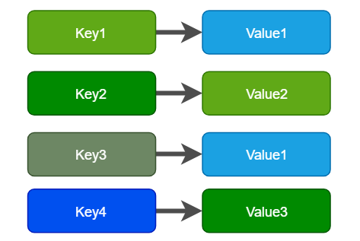
NoSQL –Not only SQL
Document Db
Graph Db
Key Value Db

Slide 20


Big Data (3V)
Byte One grain of rice
Kilobyte Cup of rice
Megabyte 8 bags of rice
Gigabyte 3 semi trucks
Terabyte 2 container ships
Petabyte Blankets Manhattan
Exabyte Blankets west coast states
Zettabyte Fills the Pacific Ocean
Yottabyte As earth-sized rice ball
Data Volume
Data Variety
Data Velocity

Slide 21



Big Data Processing
A-F
G-K
A-Z
L-P
Q-Z

Slide 22

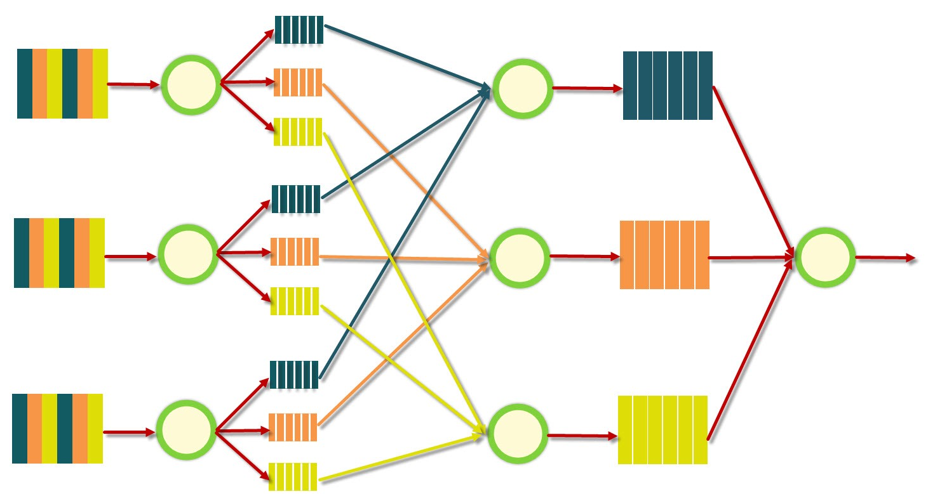



Big Data Processing
Compute
G-K
Q-Z
A-F
L-P
Data Storage

Slide 23
Big Data Processing –Data Lakes
Data
Warehouse
ETL
I(ngest) S(tore) A(nalyse) S(urface) A(ct)
Make Me More Money

Slide 24


Scalable runtime

Slide 25




Cloud

Slide 26
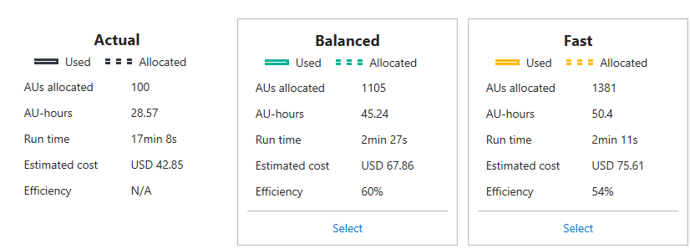
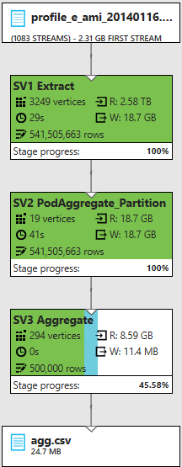
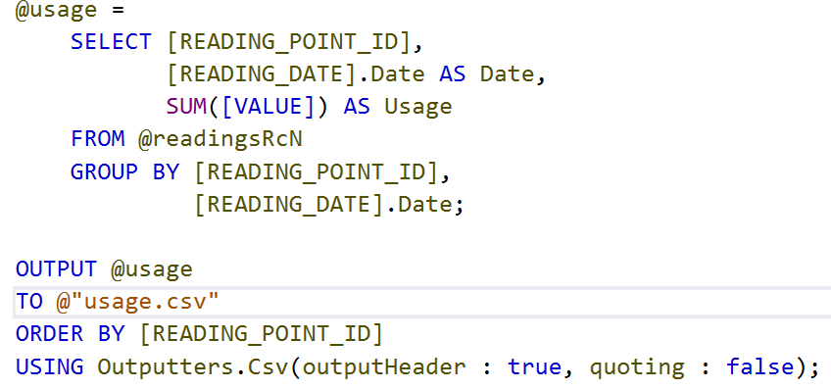
Cloud -Example

Slide 27
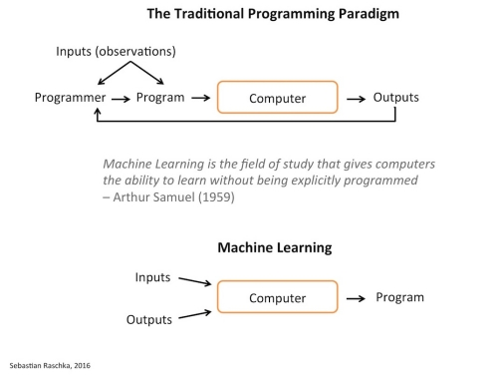
AI and Machine Learning
AI
Machine Learning
Data Science
Analytics
Big Data

Slide 28
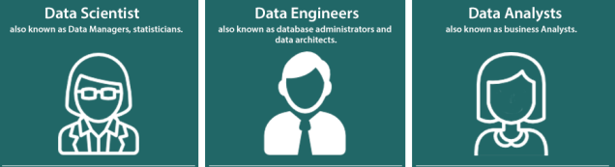
Summary
SQL - Structured Query Language
R language is a golden child of machine learning
Python is a king of machine learning

Slide 29
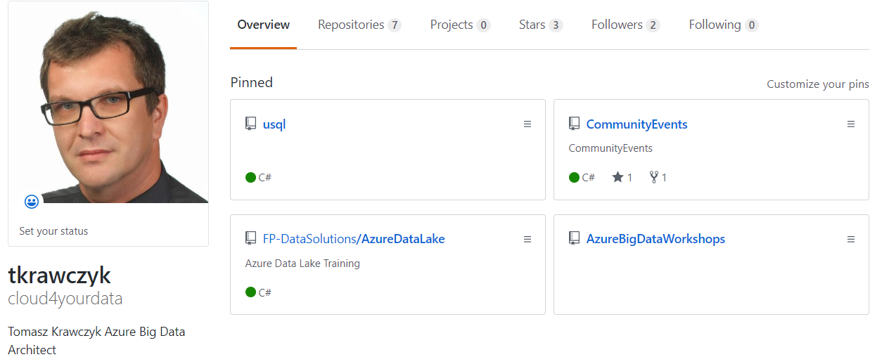


About Me
https://github.com/cloud4yourdata
https://github.com/cloud4yourdata/CommunityEvents
https://github.com/FP-DataSolutions/AzureBigDataWorkshops

Slide 30
Q & A

